Slide 1

Getting Started with AngularJS and the Open Source Stack
Presented By: Joshua Weil Joshua.weil@lexisnexis.com
Source and Slides available at:
https://github.com/weiljx/weatherNg

Slide 2
The Basics
What is AngularJS?
AngularJS is a JavaScript framework that is used for making rich, extensible web applications (SPA). It runs on plain JavaScript and HTML, so you don't need any other dependencies to make it work, and it is CSS-agnostic so you can use whatever CSS framework/methodology you want when designing your Angular application.
Angular Apps Consist of 3 main parts
Controllers – handles the logic
Scope – passed between the controller and the template (think view model)
Templates – the visual output as HTML
Very Similar to MVC (Model View Controller)
Where Model = Scope, View = Template, and Controller = Controller
http://www.learn-angular.org/#!/lessons/the-essentials

Slide 3
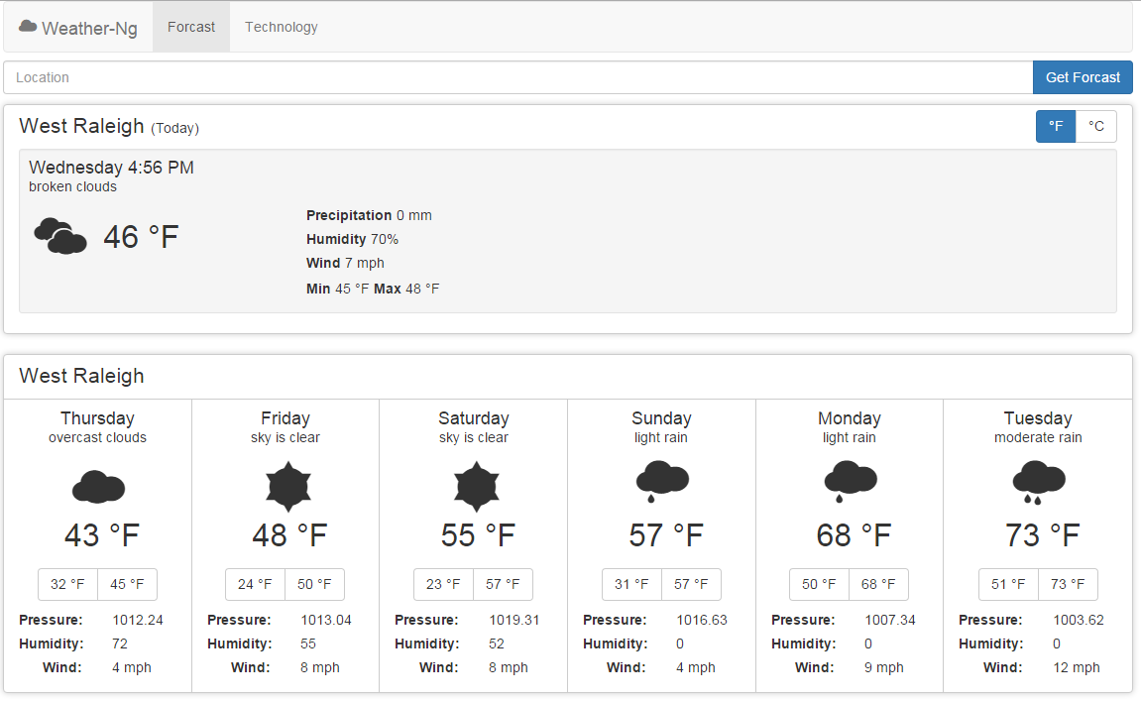
What We will Build Today
Source Code Available at
https://github.com/weiljx/weatherNg

Slide 4


Node and NPM
Open a CMD window as Administrator and type
(https://nodejs.org/en/) node --version
(https://www.npmjs.com/) npm --version
If you do not have node or npm we will need to install them
https://chocolatey.org (Windows) choco install nodejs
http://brew.sh (Mac) brew install wget
* Note you may need to close and reopen the cmd window after installing to see the versions

Slide 5

Install Git
Open a CMD window as Administrator and type
(https://git-scm.com/) git --version
If you do not have git we will need to install it
https://chocolatey.org (Windows) choco install git
http://brew.sh (Mac) brew install git
Or use an istaller from https://git-scm.com/downloads
* Note you may need to update your path variable if you see git errors later on

Slide 6


Install some packages
Install Yeoman (http://yeoman.io/)
Yeoman is a scaffolding framework npm install -g yo
Install Gulp (http://gulpjs.com/)
Gulp is a stream based Task Runner npm install -g gulp
Install Bower (http://bower.io/)
Bower is a Package manager npm install -g bower
* Note you can check versions with yo --version, gulp --version, and bower –version to ensure successful installs of these packages
* The -g means install globally so you will only ever need to do these steps once

Slide 7
Install a Generator
Install Gulp Angular Scaffold Template (https://github.com/swiip/generator-gulp-angular)
This provides the features for this npm install -g generator-gulp-angular generator
There are many generators depending on the type of tech stack you want to create
You can even create your own generator
To find more generators go to (http://yeoman.io/generators/)
* The -g means install globally so you will only ever need to do these steps once per generator

Slide 8
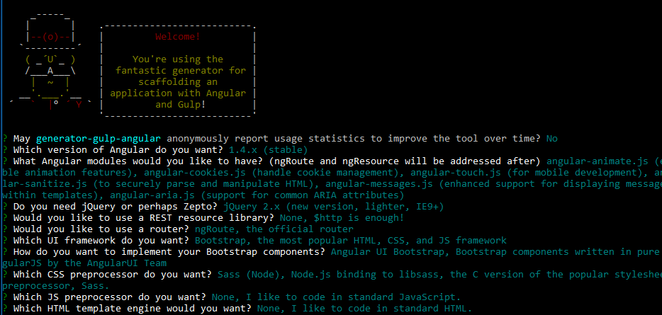
Create a Project
Generate a Scaffold Template (https://github.com/swiip/generator-gulp-angular)
Create a Directory mkdir weather
Navigate to that Directory cd weather
Start Scaffolding yo gulp-angular
Angular: 1.4.x (stable)
Modules (none)
JQuery (2.x)
Rest (none)
Router (ngRoute)
UI Framework (Bootstrap)
Angular UI
CSS Preprocessor (Sass Node)
JS Preprocessor (none)
HTML Template (none)

Slide 9
Build the Project
Install Project Dependencies with Bower
Bower Install bower install
Gulp Tasks
Gulp Build gulp build
Gulp Test gulp test
Gulp Serve gulp serve
Gulp Watch gulp watch
Setup is complete Now we can write Code

Slide 10




Lets look at the code
Use your web editor of choice (Some free ones below)
Visual Studio Code
Sublime Text
Brackets
Notepad++

Slide 11
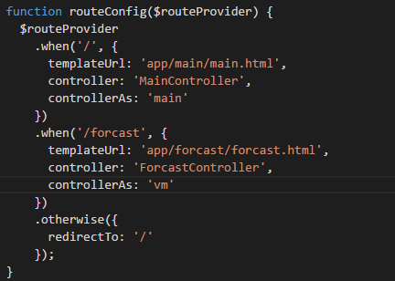
Adding a new route
The route tells the application what page to serve up based on the url path
The first parameter specifies the path that the route will register
templateUrl: specifies what template to use
controller: specifies which controller to use
controllerAs: specifies what the scope should be called
vm is a common controllerAs property and is short for “view model”
The otherwise section tells the app where to route if the path is not found
src/app/index.route.js
Snippet_01.js
Notes:
Snippet_01.js
.when('/forecast', {
templateUrl: 'app/forecast/forcast.html',
controller: 'ForecastController',
controllerAs: 'vm'
})
Using the route as a starting point we can see we need to add some files
- Add Forecast Directory
- Forecast Controller
- Forecast Template

Slide 12
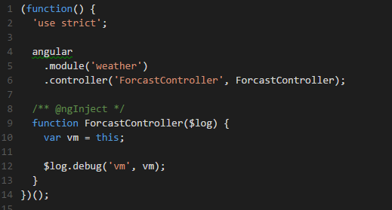
Adding a Controller
The controller will be responsible for the logic on the Forecast page
We register a new controller to our application (module)
controller: just a JavaScript Function
We set up a variable that will act as our scope and set it to this. The name of this variable should match the property you set for “controllerAs” in the previous step
ngInject does some magic for us by automatically setting up our dependency injection here we are injecting the angular $log service
https://docs.angularjs.org/guide/di
Snippet_02.js
src/app/iforecast/forecast.controller.js
Notes:
Snippet_02.js
(function() {
'use strict';
angular
.module('weather')
.controller('ForcastController', ForcastController);
/** @ngInject */
function ForcastController($log) {
var vm = this;
$log.debug('vm', vm);
}
})();

Slide 13
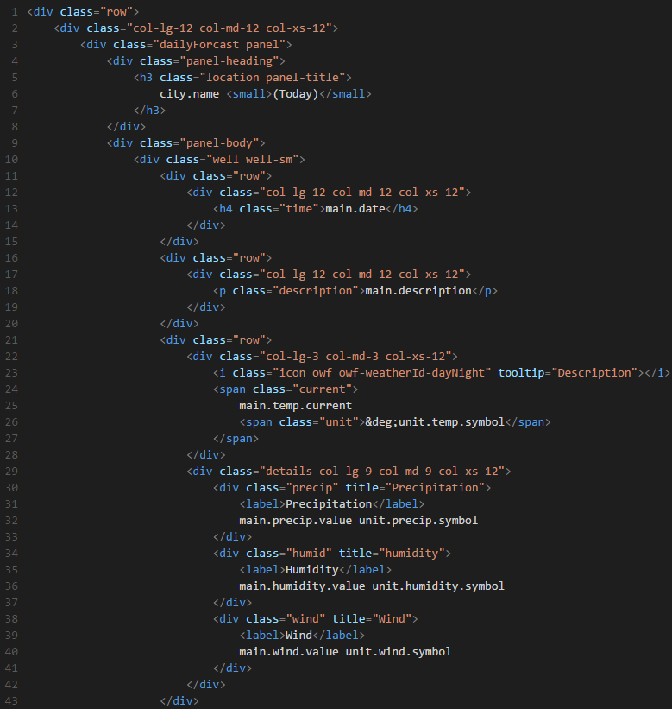
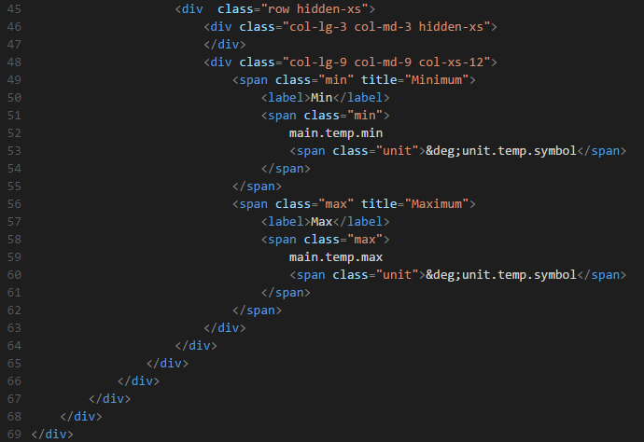
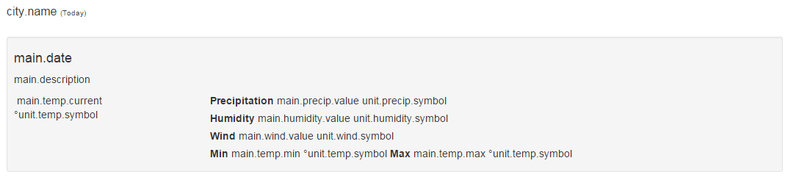
Adding a Template
The template will establish how our content is displayed, we will start with raw HTML and bootstrap
src/app/forecast/forecast.html
Snippet_03.html
Notes:
Snippet_03.html
<div class="row">
<div class="col-lg-12 col-md-12 col-xs-12">
<div class="dailyForcast panel">
<div class="panel-heading">
<h3 class="location panel-title">
city.name <small>(Today)</small>
</h3>
</div>
<div class="panel-body">
<div class="well well-sm">
<div class="row">
<div class="col-lg-12 col-md-12 col-xs-12">
<h4 class="time">main.date</h4>
</div>
</div>
<div class="row">
<div class="col-lg-12 col-md-12 col-xs-12">
<p class="description">main.description</p>
</div>
</div>
<div class="row">
<div class="col-lg-3 col-md-3 col-xs-12">
<i class="icon owf owf-weatherId-dayNight" tooltip="Description"></i>
<span class="current">
main.temp.current
<span class="unit">&deg;unit.temp.symbol</span>
</span>
</div>
<div class="details col-lg-9 col-md-9 col-xs-12">
<div class="precip" title="Precipitation">
<label>Precipitation</label>
main.precip.value unit.precip.symbol
</div>
<div class="humid" title="humidity">
<label>Humidity</label>
main.humidity.value unit.humidity.symbol
</div>
<div class="wind" title="Wind">
<label>Wind</label>
main.wind.value unit.wind.symbol
</div>
</div>
</div>
<div class="row hidden-xs">
<div class="col-lg-3 col-md-3 hidden-xs">
</div>
<div class="col-lg-9 col-md-9 col-xs-12">
<span class="min" title="Minimum">
<label>Min</label>
<span class="min">
main.temp.min
<span class="unit">&deg;unit.temp.symbol</span>
</span>
</span>
<span class="max" title="Maximum">
<label>Max</label>
<span class="max">
main.temp.max
<span class="unit">&deg;unit.temp.symbol</span>
</span>
</span>
</div>
</div>
</div>
</div>
</div>
</div>
</div>

Slide 14
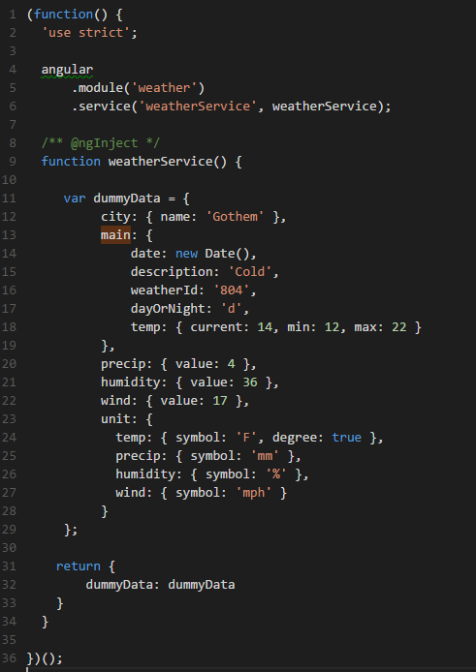
Adding a Service
A service is designed for manipulating data CRUD / REST
To start our service will serve up some dummy data, later we will request data from a external web service
The dummy data will feed the view and control what is displayed
More information on services can be found here: https://docs.angularjs.org/guide/services
src/app/components/weatherService/weather.service.js
Snippet_04.js
Notes:
Snippet_04.js
/* weather.service.js */
(function() {
'use strict';
angular
.module('weather')
.service('weatherService', weatherService);
/** @ngInject */
function weatherService() {
var dummyData = {
city: { name: 'Gothem' },
main: {
date: new Date(),
description: 'Cold',
weatherId: '804',
dayOrNight: 'd',
temp: { current: 14, min: 12, max: 22 }
},
precip: { value: 4 },
humidity: { value: 36 },
wind: { value: 17 },
unit: {
temp: { symbol: 'F', degree: true },
precip: { symbol: 'mm' },
humidity: { symbol: '%' },
wind: { symbol: 'mph' }
}
};
return {
dummyData: dummyData
}
}
})();

Slide 15
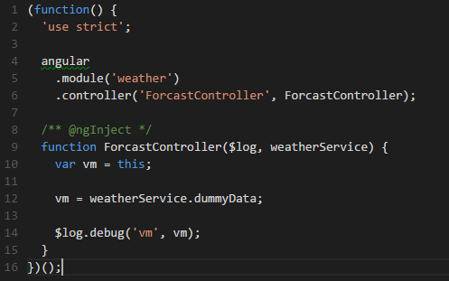
Calling our Service from a Controller
We will call our service from the forecast controller and it should log the information to the console.
Tell the controller about the service as seen on line 9
Call the exposed dummyData and set the view model to the dummyData
When you run your application you can now see the dummyData object in the console window.
Next we will bind the template to this view model
src/app/forecast/forecast.controller.js
Snippet_05.js
Notes:
Snippet_05.js
(function() {
'use strict';
angular
.module('weather')
.controller('ForcastController', ForcastController);
/** @ngInject */
function ForcastController($log, weatherService) { //inject weatherService into the controller
var vm = this;
vm = weatherService.dummyData; // call our dummyData on the weatherService
$log.debug('vm', vm);
}
})();

Slide 16
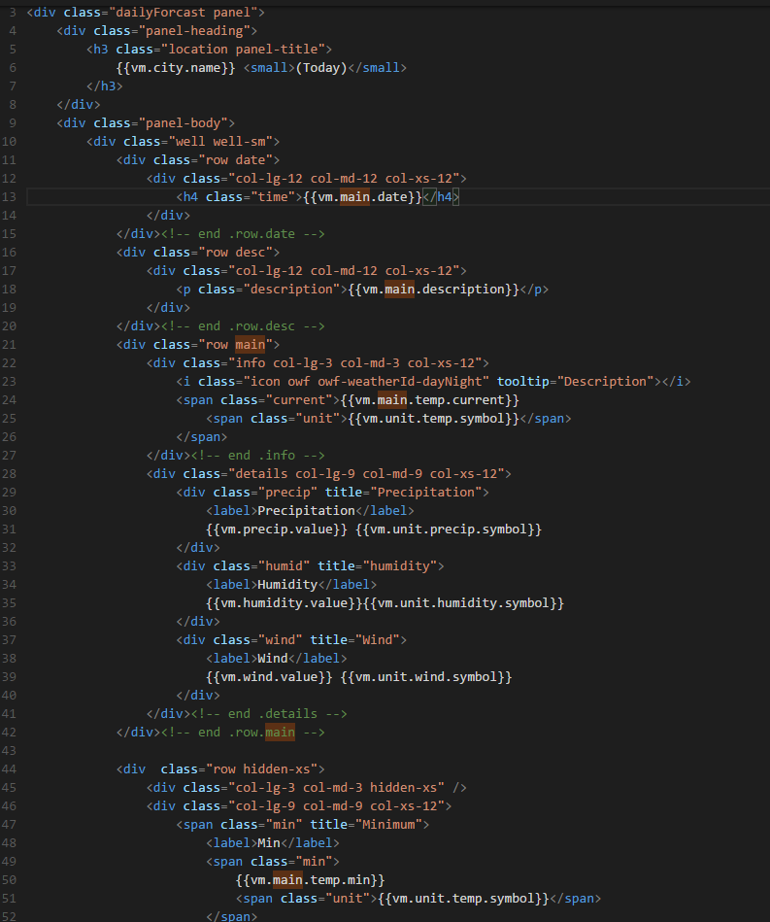
Binding our template to the View Model
We can do one way binding to our view model by calling our property inside double curly braces. {{vm.city.name}}
Using the console output as a guide replace the various references with bindings as you save you can see if you have bound the properties correctly
Don’t forget to bind the weather icon <i class="icon owf owf-{{vm.main.weatherId}}-{{vm.main.dayOrNight}}" tooltip="{{vm.main.description}}"></i>
src/app/forecast/forecast.html
Snippet_06.html
Notes:
Snippet_06.html
<!-- forecast.html -->
<div class="dailyForcast panel">
<div class="panel-heading">
<h3 class="location panel-title">
{{vm.city.name}} <small>(Today)</small>
</h3>
</div>
<div class="panel-body">
<div class="well well-sm">
<div class="row date">
<div class="col-lg-12 col-md-12 col-xs-12">
<h4 class="time">{{vm.main.date}}</h4>
</div>
</div><!-- end .row.date -->
<div class="row desc">
<div class="col-lg-12 col-md-12 col-xs-12">
<p class="description">{{vm.main.description}}</p>
</div>
</div><!-- end .row.desc -->
<div class="row main">
<div class="info col-lg-3 col-md-3 col-xs-12">
<i class="icon owf owf-{{vm.main.weatherId}}-{{vm.main.dayOrNight}}" tooltip="{{vm.main.description}}"></i>
<span class="current">{{vm.main.temp.current}}
<span class="unit">{{vm.unit.temp.symbol}}</span>
</span>
</div><!-- end .info -->
<div class="details col-lg-9 col-md-9 col-xs-12">
<div class="precip" title="Precipitation">
<label>Precipitation</label>
{{vm.precip.value}} {{vm.unit.precip.symbol}}
</div>
<div class="humid" title="humidity">
<label>Humidity</label>
{{vm.humidity.value}}{{vm.unit.humidity.symbol}}
</div>
<div class="wind" title="Wind">
<label>Wind</label>
{{vm.wind.value}} {{vm.unit.wind.symbol}}
</div>
</div><!-- end .details -->
</div><!-- end .row.main -->
<div class="row hidden-xs">
<div class="col-lg-3 col-md-3 hidden-xs" />
<div class="col-lg-9 col-md-9 col-xs-12">
<span class="min" title="Minimum">
<label>Min</label>
<span class="min">
{{vm.main.temp.min}}
<span class="unit">{{vm.unit.temp.symbol}}</span>
</span>
</span>
<span class="max" title="Maximum">
<label>Max</label>
<span class="max">
{{vm.main.temp.max}}
<span class="unit">{{vm.unit.temp.symbol}}</span>
</span>
</span>
</div>
</div><!-- end .hidden-xs -->
</div><!-- end .well -->
</div><!-- end .panel-body -->
</div><!-- end .dailyForcast.panel -->

Slide 17

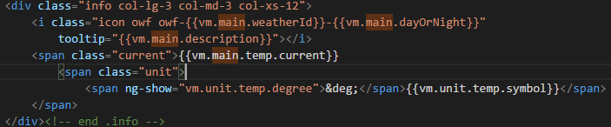
Using Built in Filters and Directives
Filters Allow us to format the value of an expression. Lets use a filter on our date object to display the day of the week. Use this link as a reference: https://docs.angularjs.org/api/ng/filter/date
Directives are markers on a DOM element that tell Angular to compile and attach a specified behavior to that Dom Element. Some Examples include: (ng-show, ng-hide, ng-class, and ng-model)
Using a directive decide to show or hide a DOM element to display the degrees symbol before the unit.temp.symbols (Note that the HTML encoding for the degree symbol is &deg;)
Apply this logic to the min and max temp as well
src/app/forecast/forecast.html
Snippet_07.html
Notes:
Snippet_07.html
<!-- forecast.html -->
<div class="dailyForcast panel">
<div class="panel-heading">
<h3 class="location panel-title">
{{vm.city.name}} <small>(Today)</small>
</h3>
</div>
<div class="panel-body">
<div class="well well-sm">
<div class="row date">
<div class="col-lg-12 col-md-12 col-xs-12">
<h4 class="time">{{vm.main.date | date:'EEEE'}}</h4>
</div>
</div><!-- end .row.date -->
<div class="row desc">
<div class="col-lg-12 col-md-12 col-xs-12">
<p class="description">{{vm.main.description}}</p>
</div>
</div><!-- end .row.desc -->
<div class="row main">
<div class="info col-lg-3 col-md-3 col-xs-12">
<i class="icon owf owf-{{vm.main.weatherId}}-{{vm.main.dayOrNight}}" tooltip="{{vm.main.description}}"></i>
<span class="current">{{vm.main.temp.current}}
<span class="unit"><span ng-show="vm.unit.temp.degree">&deg;</span>{{vm.unit.temp.symbol}}</span>
</span>
</div><!-- end .info -->
<div class="details col-lg-9 col-md-9 col-xs-12">
<div class="precip" title="Precipitation">
<label>Precipitation</label>
{{vm.precip.value}} {{vm.unit.precip.symbol}}
</div>
<div class="humid" title="humidity">
<label>Humidity</label>
{{vm.humidity.value}}{{vm.unit.humidity.symbol}}
</div>
<div class="wind" title="Wind">
<label>Wind</label>
{{vm.wind.value}} {{vm.unit.wind.symbol}}
</div>
</div><!-- end .details -->
</div><!-- end .row.main -->
<div class="row hidden-xs">
<div class="col-lg-3 col-md-3 hidden-xs" />
<div class="col-lg-9 col-md-9 col-xs-12">
<span class="min" title="Minimum">
<label>Min</label>
<span class="min">
{{vm.main.temp.min}}
<span class="unit"><span ng-show="vm.unit.temp.degree">&deg;</span>{{vm.unit.temp.symbol}}</span>
</span>
</span>
<span class="max" title="Maximum">
<label>Max</label>
<span class="max">
{{vm.main.temp.max}}
<span class="unit"><span ng-show="vm.unit.temp.degree">&deg;</span>{{vm.unit.temp.symbol}}</span>
</span>
</span>
</div>
</div><!-- end .hidden-xs -->
</div><!-- end .well -->
</div><!-- end .panel-body -->
</div><!-- end .dailyForcast.panel -->

Slide 18
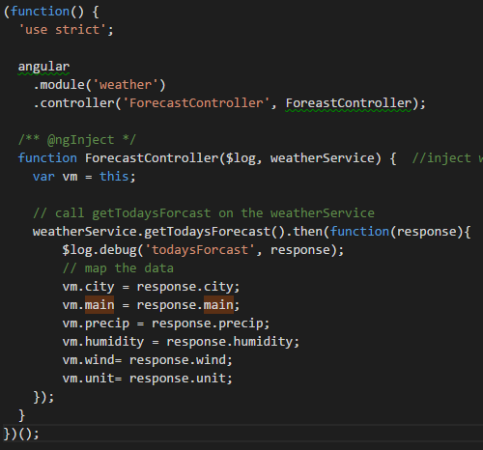
Getting the Weather
Lets make our weather service smarter by calling a REST endpoint on an open source weather provider
Create a function in the weatherService called getTodaysForecast
To start we should inject $q, $http, and $log into the weatherService
We should construct the following url http://api.openweathermap.org/data/2.5/weather?q=raleigh&appid=92746992a90ad66da7b9553b006d6e07&mode=json&units=imperial
Then using the $http service perform a get operation on the url we constructed above
Inside the promise format the data to mimic dummyData (note we will need to use the $q service to create a defered to do the formatting in the service)
When we are done we will call the new getTodaysForecast function from the forecast controller and map the data from the promise to the view model
Lets walk through this together using snippet_08.js as a reference
src/app/forecast/forecast.controller.js
Snippet_08.js
Notes:
Snippet_08.js
/* weather.service.js */
(function() {
'use strict';
angular
.module('weather')
.service('weatherService', weatherService);
/** @ngInject */
function weatherService() {
var dummyData = {
city: { name: 'Gothem' },
main: {
date: new Date(),
description: 'Cold',
weatherId: '804',
dayOrNight: 'd',
temp: { current: 14, min: 12, max: 22 }
},
precip: { value: 4 },
humidity: { value: 36 },
wind: { value: 17 },
unit: {
temp: { symbol: 'F', degree: true },
precip: { symbol: 'mm' },
humidity: { symbol: '%' },
wind: { symbol: 'mph' }
}
};
return {
dummyData: dummyData
}
}
})();

Slide 19
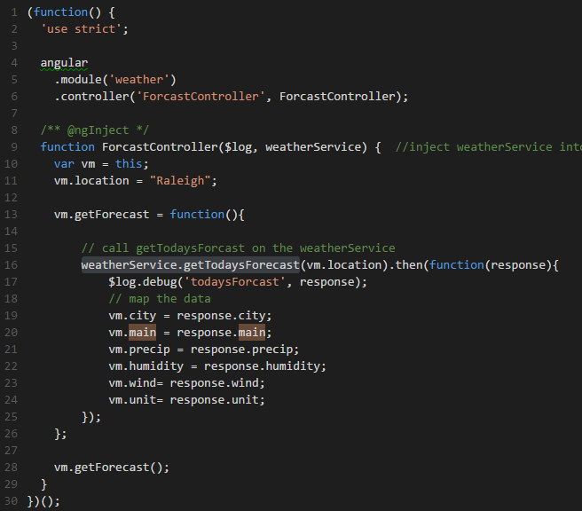
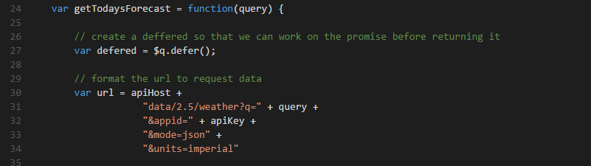
Adding a Location Search
Lets allow our application to accept different locations.
Add an input and button at the top of the forecast template to allow the user to enter a location, on the input add ng-model=“vm.location”, and on the button add ng-click=“vm.getWeather”
Create a function in the forecast controller called vm.getWeather() have it pass the vm.location to the weatherService.getTodaysForecast function
In the weather service alter the getTodaysForecast function to take a location parameter and use it to update the url
src/app/forecast/forecast.controller.js
src/app/components/weatherService/weather.service.js
Snippet_09.js

Slide 20
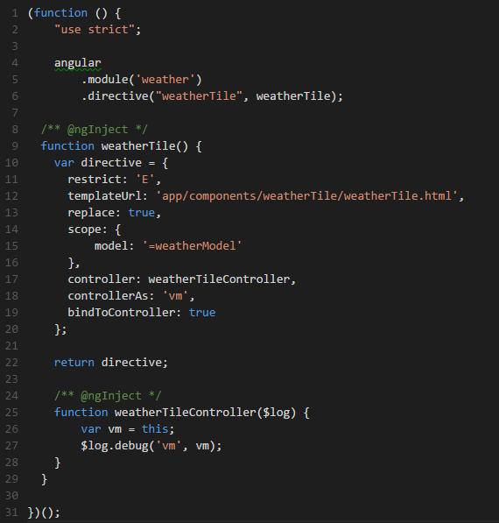
Adding a Directive
For a weekly forecast we can create a directive that will be repeated
We will create a weatherTile Directive consisting of 3 parts
Template: weatherTile.html
Stylesheet: weatherTile.scss
Directive: weatherTile.directive.js
Restrict tells angular how to find the directive in the DOM
A: Only matches attribute name
C: Only matches class name
E: Only matches element name
Scope tells the directive where to get information from
<weather-tile weather-model=“vm.model"></weather-tile>
https://docs.angularjs.org/guide/directive
src/app/components/weatherTile/weatherTile.directive.js
Snippet_10.js

Slide 21
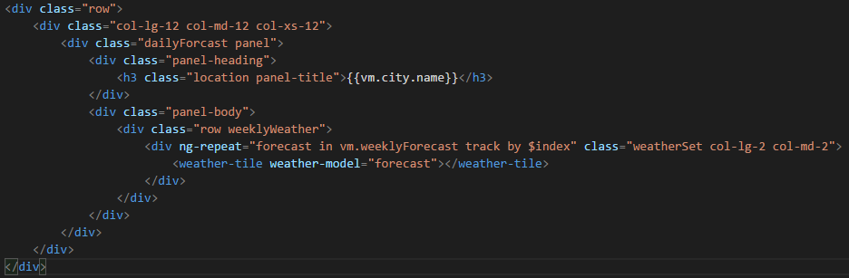
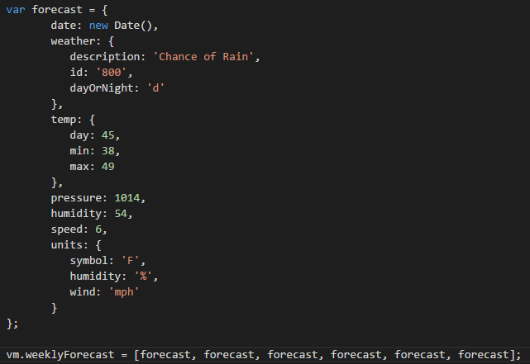
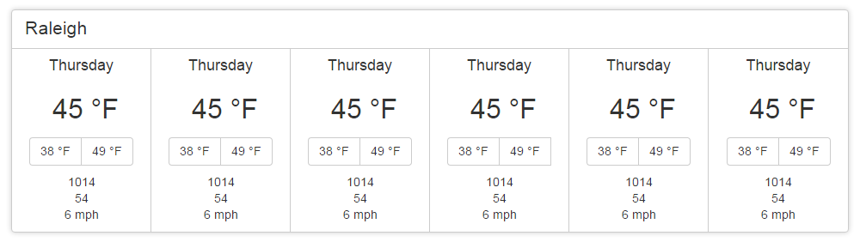
Wiring up the Directive
For a weekly forecast we can create a directive that will be repeated
Add a call to the directive in the forecast template.
In this case we call the directive inside another built in directive called ng-repeat which will allow us to loop over a collection
In the forecast controller we can set up some dummy data to see our directive in action
src/app/components/weatherTile/weatherTile.html
src/app/forecast/forecast.controller.js
Snippet_11.js
Notes:
Snippet_04.js
/* weather.service.js */
(function() {
'use strict';
angular
.module('weather')
.service('weatherService', weatherService);
/** @ngInject */
function weatherService() {
var dummyData = {
city: { name: 'Gothem' },
main: {
date: new Date(),
description: 'Cold',
weatherId: '804',
dayOrNight: 'd',
temp: { current: 14, min: 12, max: 22 }
},
precip: { value: 4 },
humidity: { value: 36 },
wind: { value: 17 },
unit: {
temp: { symbol: 'F', degree: true },
precip: { symbol: 'mm' },
humidity: { symbol: '%' },
wind: { symbol: 'mph' }
}
};
return {
dummyData: dummyData
}
}
})();

Slide 22
Getting our weekly forecast data
Try this on your own
Try on your own to add a function to the weatherService called getWeeklyForecast(location)
The url to retrieve the data should look like the following http://api.openweathermap.org/ data/2.5/weather?q=<location>&appid= 92746992a90ad66da7b9553b006d6e07&mode=json&units=imperial&cnt=7
This method should format the data to our expectation based on the dummy data from the last slide (logging out the response will allow you to get an idea for how to transform it to the dummy data format)
Call the getWeeklyForecast() method you created from the getForecast() method of the forecast controller, remember to send the location
As an added bonus see if you can toggle between Fahrenheit and Celsius this can be achieved by setting units=imperial for Fahrenheit or units=metric for Celsius on the urls to the open weather API. More information can be found at http://openweathermap.org/api
Snippet_12.js
Notes:
Snippet_04.js
/* weather.service.js */
(function() {
'use strict';
angular
.module('weather')
.service('weatherService', weatherService);
/** @ngInject */
function weatherService() {
var dummyData = {
city: { name: 'Gothem' },
main: {
date: new Date(),
description: 'Cold',
weatherId: '804',
dayOrNight: 'd',
temp: { current: 14, min: 12, max: 22 }
},
precip: { value: 4 },
humidity: { value: 36 },
wind: { value: 17 },
unit: {
temp: { symbol: 'F', degree: true },
precip: { symbol: 'mm' },
humidity: { symbol: '%' },
wind: { symbol: 'mph' }
}
};
return {
dummyData: dummyData
}
}
})();

Slide 23
Getting Started with AngularJS and the Open Source Stack
Presented By: Joshua Weil Joshua.weil@lexisnexis.com
Source and Slides available at:
https://github.com/weiljx/weatherNg

